Slide 1
Cubing, Outbound VAS and Order Consolidation

Slide 2
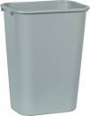
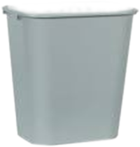
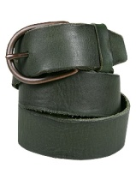
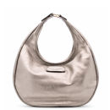
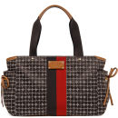
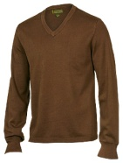
Cubing
Cubing is process that Determines the optimal contents to be packed into Cartons.
Cubing can either be a manual one or the system
WM initiates cubing after inventory allocation has occurred and WM has determined the quantities to be fulfilled from the different inventory buckets (Active, Case Pick, or Reserve).
There are two concepts within cubing:
Full Case Cubing
Cube to Capacity.
VS

Slide 3
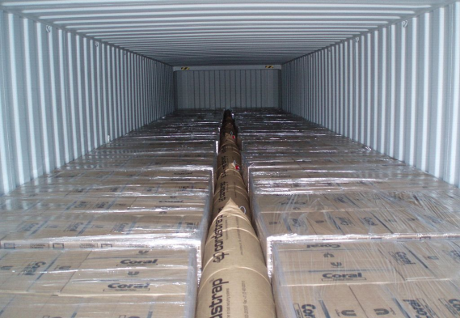

Cubing (Contd.)
Cubing to capacity is done based on Multiple Criteria
Item weight, volume,
Critical dimensions
Placing Items and quantities into cartons in pick location sequence (to minimize the pick travel path
Dunnage
Dunnage

Slide 4



Outbound VAS
If the order falls under discounts or if the order requires any deductions based on the discount then its calculated in this stage .
If Orders requiring Gift Wrap processing will be isolated via a separate wave.
The need for Gift Wrap and the gift message will be printed on the collate document,
VAS information is based on information provided on the Distribution Order header

Slide 5


Outbound VAS Services
Gift-wrapping each individual package with a personalized card.
Monogramming on garments.
Grinding coffee seeds to the required grind level.
Assembly of a mobile phone with the appropriate front panel.
Consolidated offers
Price Label will be printed in VAS
E.g.: Full computer assembled set

Slide 6
Order Consolidation
Order Consolidation is the assignment of an outbound location to cartons of similar characteristics.
The purpose of order consolidation is two-fold: 1) to consolidate multiple cartons of a single order 2) to combine like orders together for lower shipping charges.
It is possible to define many different physical storage areas in the warehouse as WM order consolidation locations.
Single pallet positions,
Multiple pallet positions,
Divert lanes of a conveyor,
Staging areas near a dock door

Slide 7
Methods Order Consolidation
There are three methods of order consolidation. 1. The first method uses a series of lock flags, rules, and profiles to consolidate orders. 2. The second is “anchoring,” which involves palletizing cartons with similar characteristics and possibly tying the pallets to a staging location. 3. The third is “staging,” which involves random putaway of cartons or pallets to staging locations.
Order Consolidation with the Pick Wave can be set up to use either permanent locations or temporary locations.

Slide 8
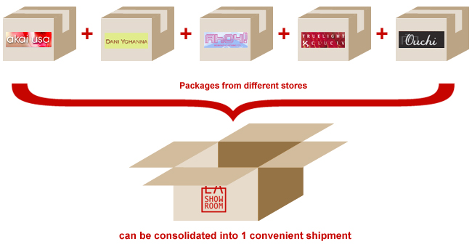
Order Consolidation(Contd.)
Order Consolidation is merging of Picktickets
Carter’s uses 3 different consolidation criteria
Consolidate Picktickets with the same sold to, ship to & not before ship date
Consolidate Picktickets with the same sold to, ship to & PO.
Consolidate Picktickets with the same sold to, ship to.

